Slide 1
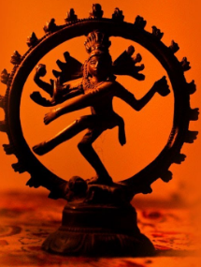

Decoding VR Gaming by The Lens of NatyaShastra
With Mayuresh Gupta

Slide 2
What Is Art?

Slide 3
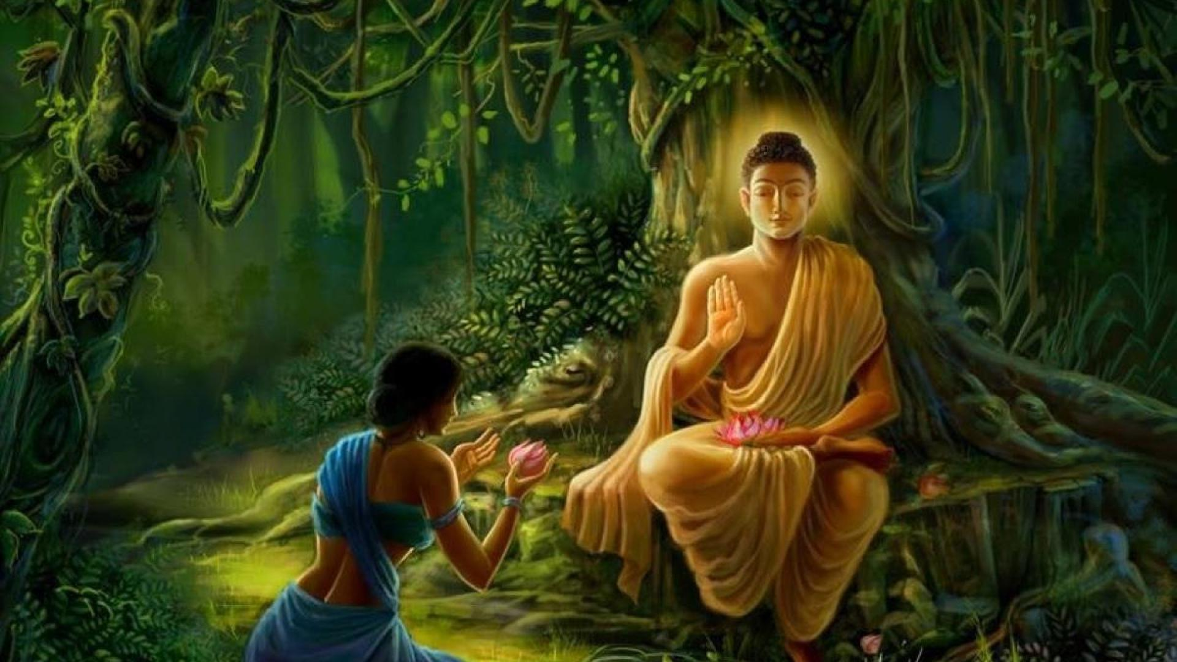
Discovered
Misery
Joke

Slide 4

Shringaram (attractiveness)
Hasyam (humor)
Raudram (rage)
Karunyum (compassion)
Bibhatsam (disgust)
Bahyanakam (horror)
Veeram (heroism)
abhutam( amazement)

Slide 5
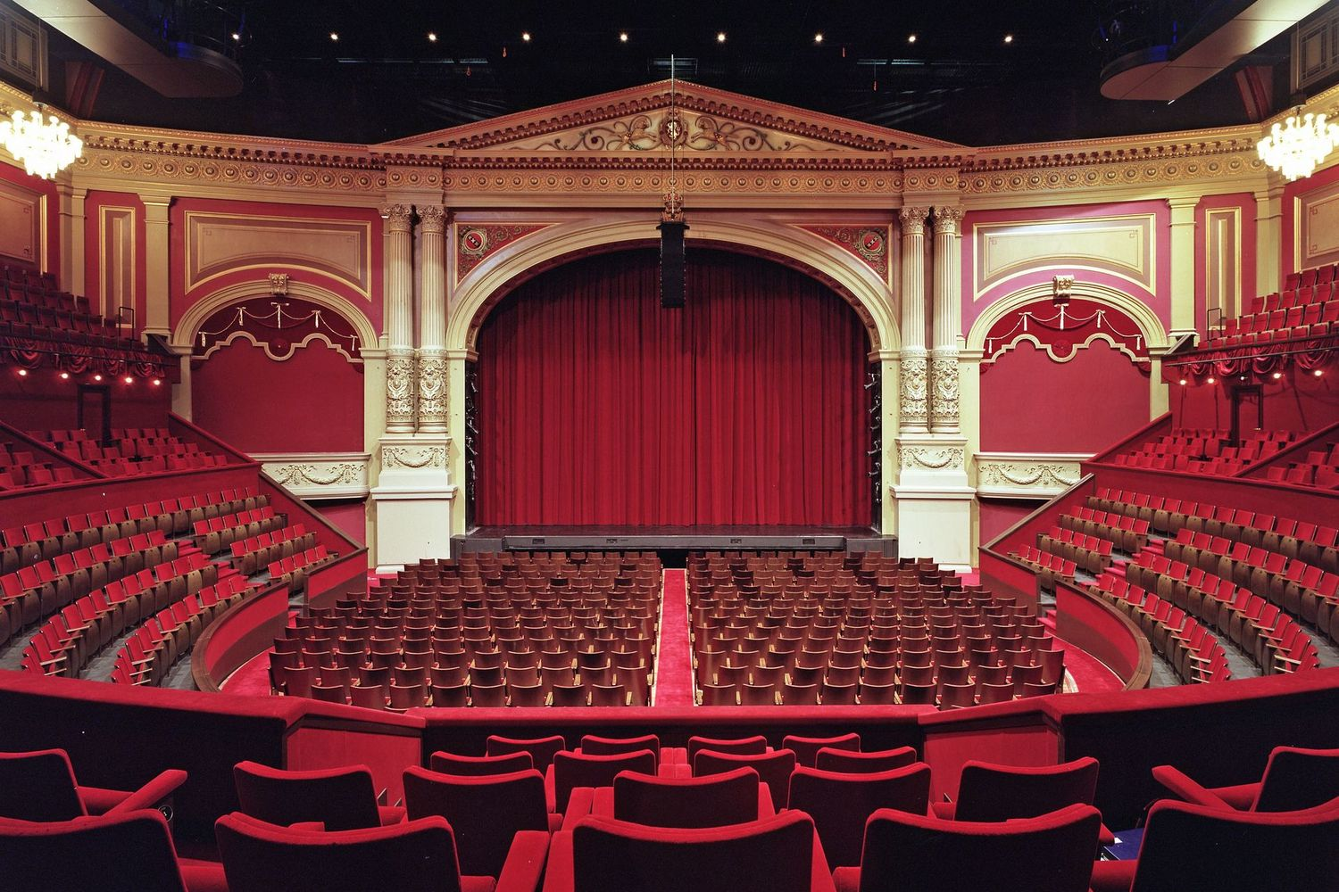
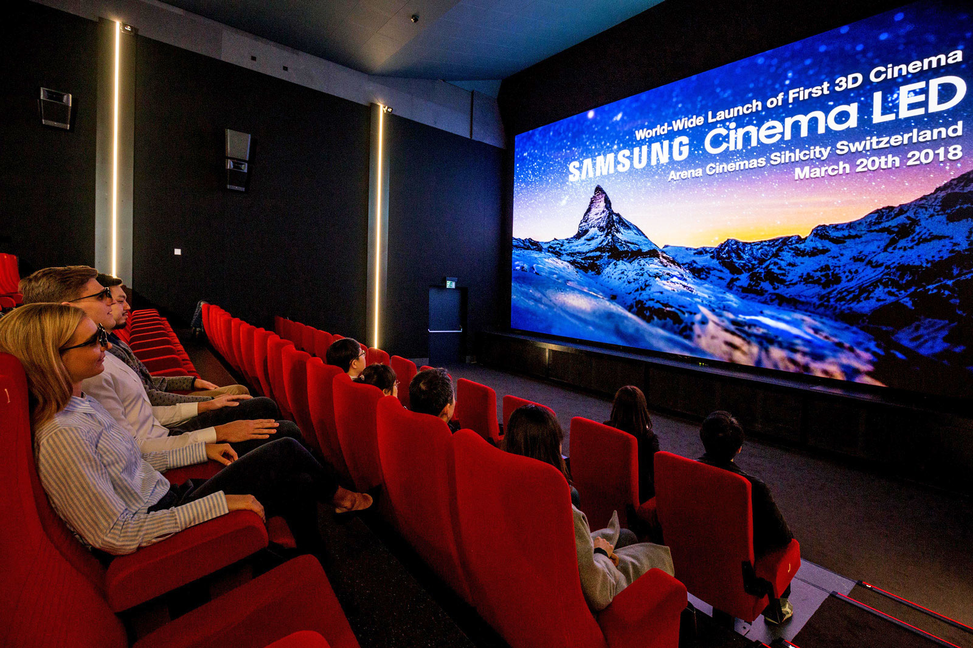
Sounds
Visuals
Lights
Dance
Theater
Cinema

Slide 6

Interactive

Slide 7
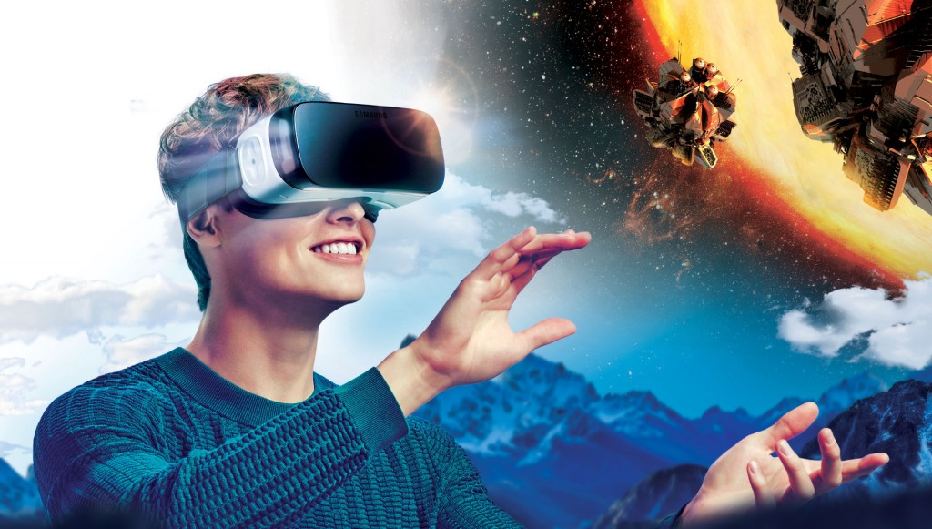
Virtual Reality

Slide 8
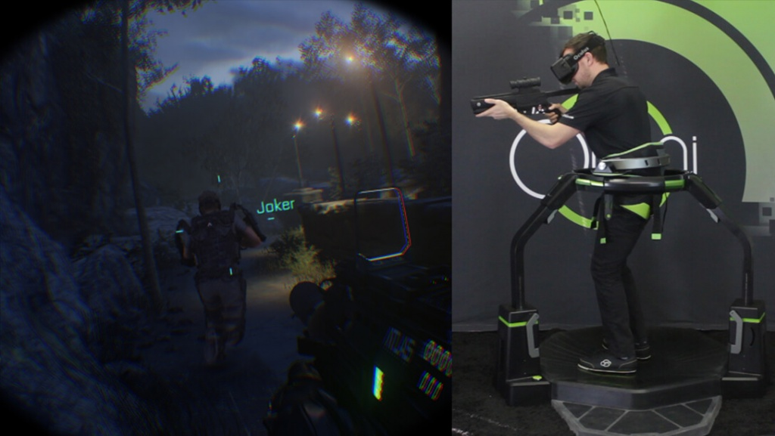

Locomotion

Slide 9
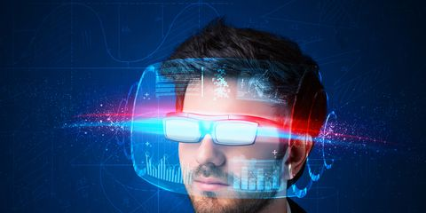
Future

Slide 10


